Slide 1



House Price prediction using ML
Members
Piyush kasle
Hardik prajapati
Ronit Patange
MS. SHILPA PATIL
Project Superviser and Guide

Slide 2

Automation is good as,so as long you know exactly where to put the machine
Eliyahu Goldart

Slide 3

Introduction
We propose to implement a house price prediction model.
It's a Machine Learning model which integrates Data Science and Web Development.
Housing prices fluctuate on a daily basis and are sometimes exaggerated rather than based on worth.
This project's main goal is to forecast property prices using accurate variables.
This model can be used by both house sellers and buyers.

Slide 4
Problem Statement
Prices of real estate properties are sophisticatedly
Proper and Justified prices of properties can bring in a lot of transparency and trust back to the real estate industry, which is very important to most consumers.
To Create a model to estimate the price of houses using ML

Slide 5
Project Specification
1.This project is to predict house prices based on features like location size/area, no. of bedrooms, no. of bathrooms and the amenities available.
2.We are using Machine Learning Algorithm to create a predictive model.
3.Proper and Justified prices of properties can bring in a lot of transparency and trust back to the real estate industry, which is very important to most consumers.

Slide 6






Through Agents
Machine Learning aproach
In this method a buyer goes to Real estate agent and ask for the house, after taking so much time the buyer finaly get a landlored owner.
The User or buyer don't have to go to agents He can just register himself and compare the house prices along with the trends
TIME CUNSUMING
COSTLY
USER FRIENDLY
POCKET FRIENDLY
INVESTMENT PLANS

Slide 7

What is ML?
Using the technique of machine learning (ML), which is a form of artificial intelligence (AI), software programmes can predict outcomes more accurately without having to be explicitly instructed to do so. In order to forecast new output values, machine learning algorithms use historical data as input.

Slide 8






Programming languages & Frameworks
HTML5
CSS3
Flask
NumPy
Pandas

Slide 9
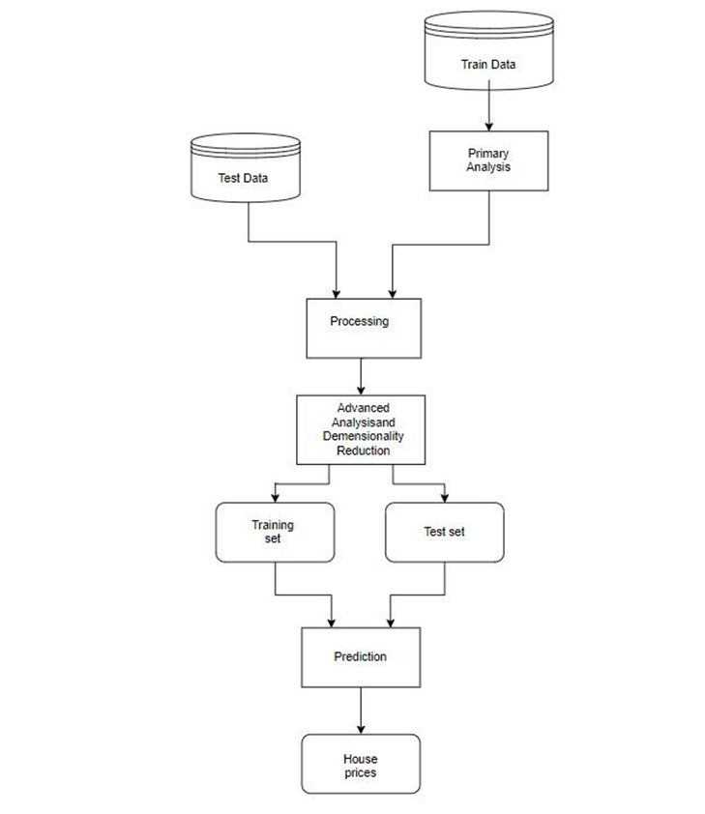
Block diagram

Slide 10
